Slide 1
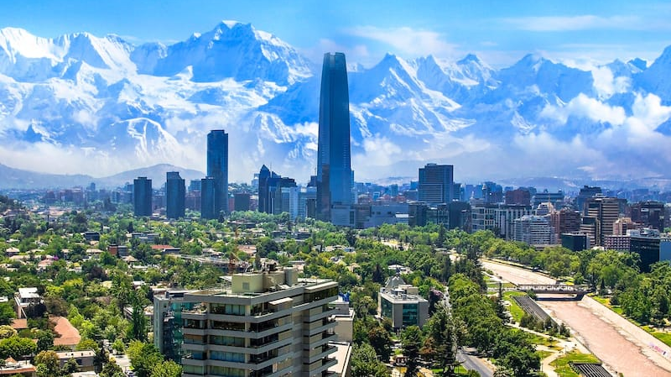



Chile & Perú Risk Analysis
Team 5: Alba, Alejandra, Julia, Viktor

Slide 2
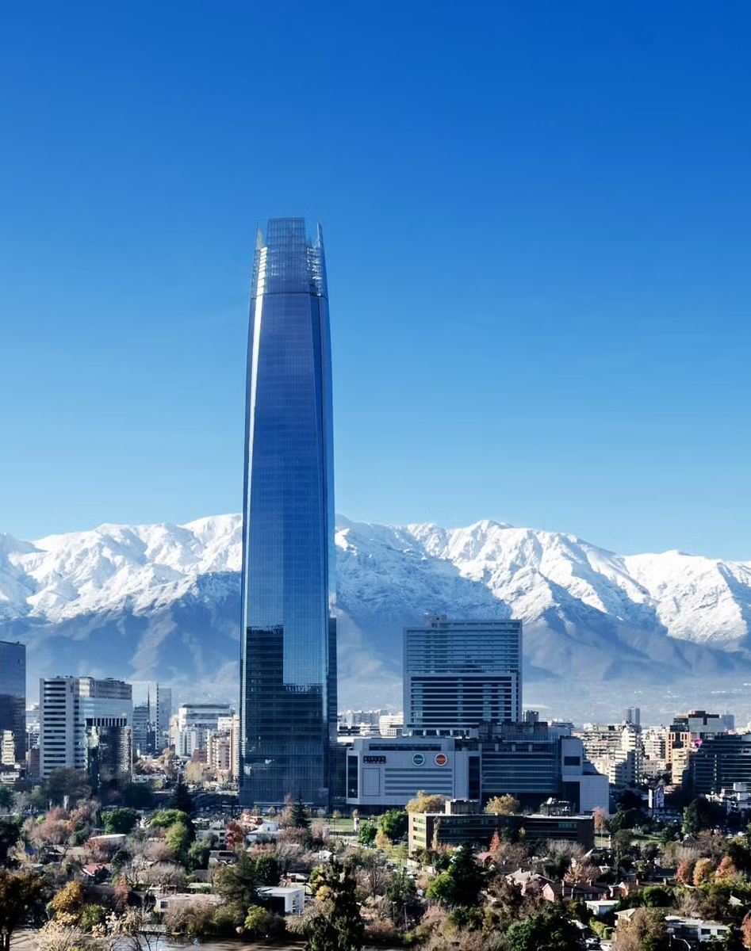
Table of Contents
Profiles
Socioeconomic climate
Data & Indicators
Macroeconomic indicators
Conclusion

Slide 3
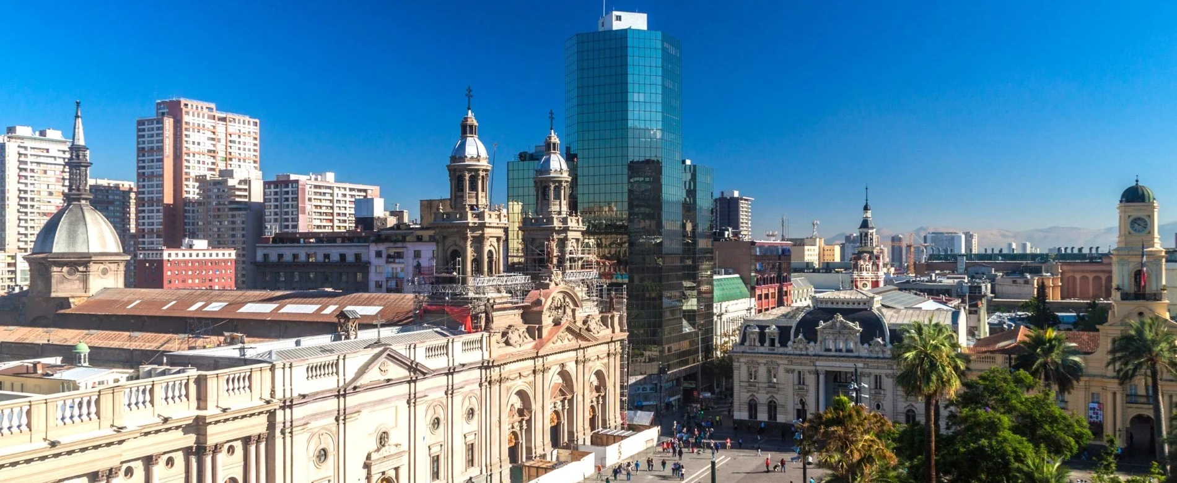
Socioeconomic Profile of Chile

Slide 4
Current Economic

Slide 5
Sociopolitical background

Slide 6
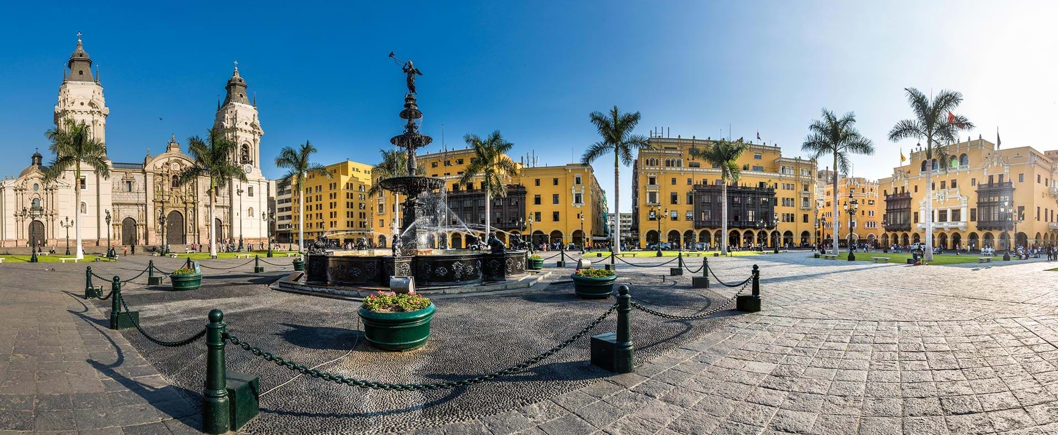
Socioeconomic Profile of Peru

Slide 7
Current Economic

Slide 8
Sociopolitical background

Slide 9
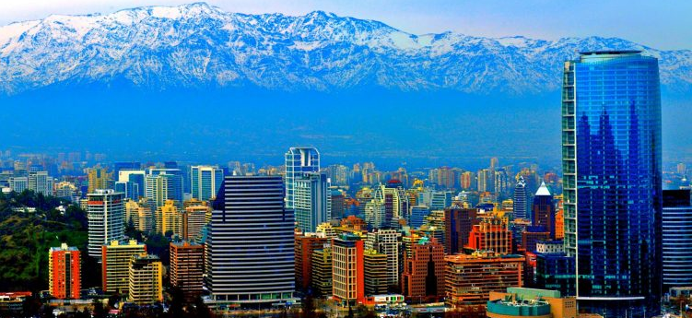
Data & Indicators

Slide 10
Real GDP

Slide 11
Budget deficit

Slide 12
Private Debt-to-GDP

Slide 13
Government Debt-to-GDP

Slide 14
External Debt-to-GDP

Slide 15
Inflation

Slide 16
Total Reserves

Slide 17
Current Account Balance

Slide 18
Conclusion

Slide 19
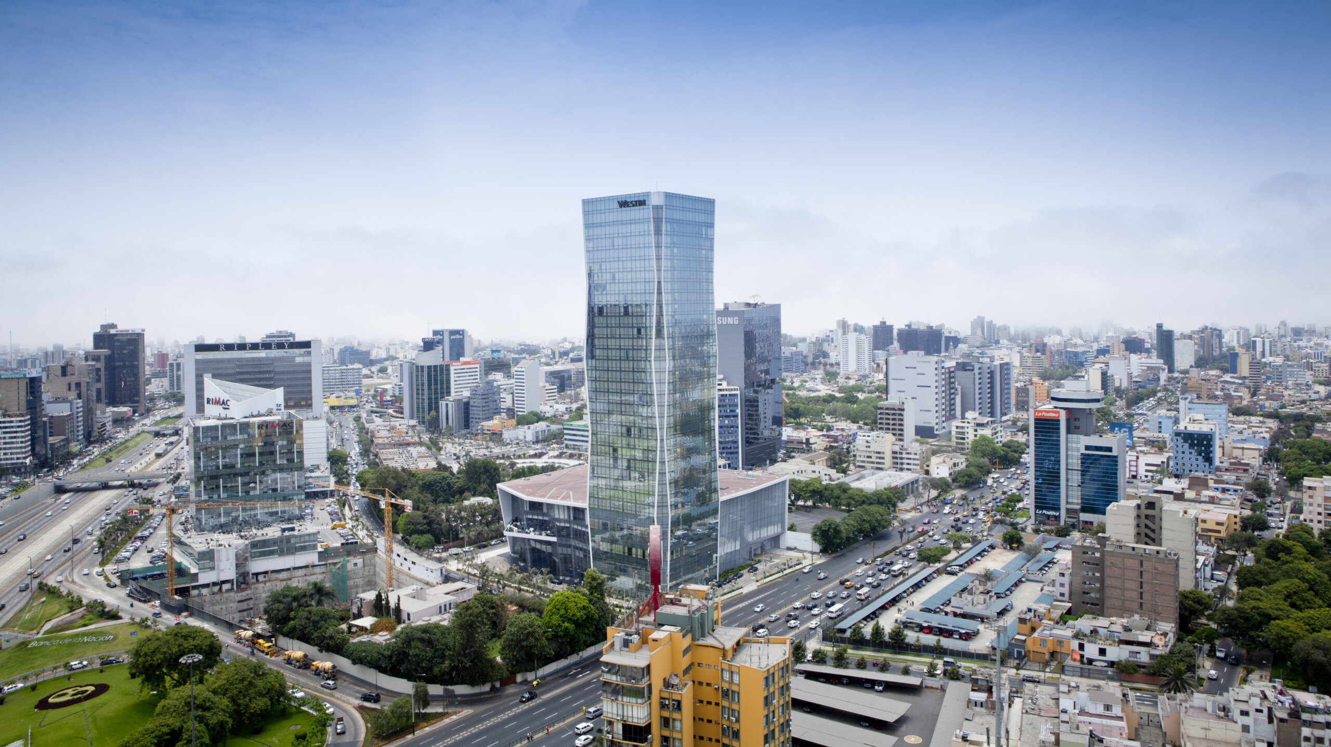
¡Gracios por su atención!

